Slide 1
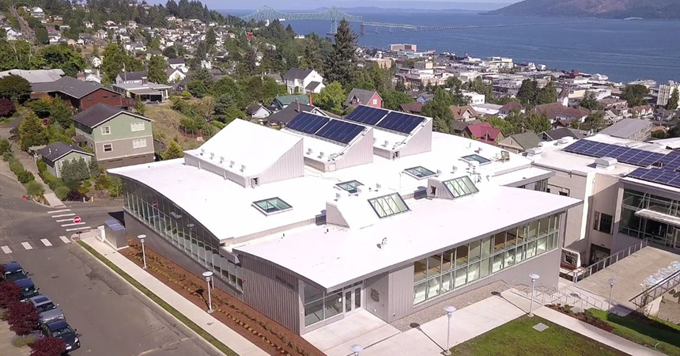
OREGON COMMUNITY SOLAR
Social Media Strategy for Project Managers

Slide 2
Goals

Slide 3
Goals
Project managers can use Facebook and Twitter to:
Raise awareness of your project and community solar as innovative and accessible
Build a community of individuals and organizations that support and advocate for your project
Increase engagement and followers on your social media channels
Recruit subscribers to your project

Slide 4
Keep in Mind…
People share social media content when it…
Reinforces their identity, perspective or opinion.
Helps them feel connected to others.
Delivers value to their followers.
Is likely to get likes, shares, and positive comments from their network.

Slide 5
Content Strategy

Slide 6
Think About Your Long-Term Narrative
Your organization has history, scope, achievements and goals, and it can be easy to forget that your audience probably isn’t aware of most of that story.
Mapping out a content plan or editorial calendar will allow you to touch on all different aspects of your story in a way that feels natural and authentic. Start with a timely topic or an upcoming event and think about how you can use it as an opportunity to tell your audience a little more about you.
For example, if you’re participating in an upcoming workshop, instead of simply promoting the time and date, think about ways you can add information or stories that will give your audience important context around the event — and your organization.
Over time, having an editorial calendar will help your social presence feel more consistent and cohesive. It can also take away the struggle of thinking of what to post about, or scrambling to come up with something at the last minute.

Slide 7
Connect Your Organization to Your Community
To most of your audience, the most compelling thing about your organization is not just that it’s doing good — it’s that it’s doing good in their community.
Lean into this by including details, stories and images that remind your followers that you’re in their neighborhood. Setting the scene will pique their interest and make your message more memorable; it will also give your brand credibility that pays off in the long run.
Localizing your content also makes your social media accounts welcoming to curious neighbors or clients who may be unfamiliar with the way community solar projects work. At the same time, it can help keep you from developing a habit of sharing too much industry news, which often falls flat on social media if it’s too dry or abstract, or intended for an insider audience.

Slide 8
Share Real Stories With Real Impacts
Community solar programs aren’t familiar to many people, even if they follow your social media accounts. Therefore, it’s important to humanize your brand and to make your content as accessible as possible.
This means using natural language to tell your story, keeping it simple and explaining unfamiliar terms and concepts if necessary. Make your points more meaningful by taking care to connect them to real-world outcomes that the layperson can understand and appreciate.
For example, if you’re talking about a family that has participated in your program, don’t just focus on the technical details and financial rewards. Dig a little deeper to show how it’s changed their lives or their perspective, or how they’ve benefitted in ways they didn’t expect. Telling a human story will give your content much broader and longer-lasting appeal.
In the end, your goal should be to communicate the value of your work as clearly as possible — leading to more followers and increased engagement.

Slide 9
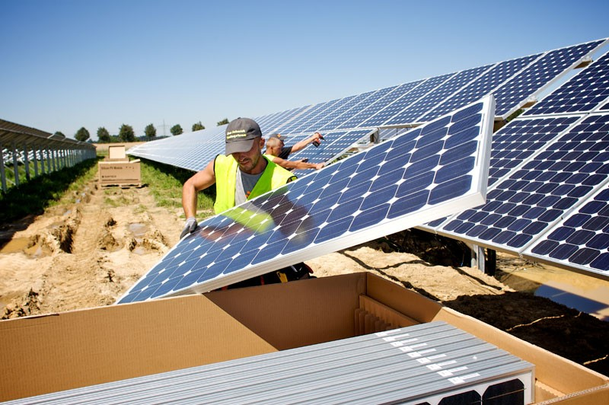
Promote Your Program!
Although it may seem counterintuitive, a good rule of thumb is to limit explicitly self-promotional posts to about 10% of what you share. Think of these as posts that make a direct “ask” of your audience, like “Sign up for our project!” If you’re asking your followers to take the same action over and over, they’re likely to lose interest pretty quickly.
But a well-timed promotional post can stand out with a clear call-to-action and a compelling visual. Point to a webpage where users can easily take action or learn more. And don’t say more than you need to — a strong value proposition should speak for itself.

Slide 10
Best Practices

Slide 11
Social Media Best Practices
Complete your profile. Don’t stop after uploading a profile picture (use your logo!) — also make sure to:
Upload a high-quality cover photo that does not contain text — this is a great place for a photo of an installation
Include your contact info, including your website and location
Give a short description in your bio, e.g., “Bringing accessible solar to Corvallis since 2013”
Share high-quality photos and video. This is the best way to attract the attention in a busy feed.
Photos perform best. Posts with pictures do better than videos, status updates and links, so be sure to share your story through visuals

Slide 12
Social Media Best Practices
Upload videos directly. This will allow your followers to preview and watch your video without navigating to YouTube.
Tag your partners. This helps increase engagement and discoverability, and can expose your organization to new audiences.
Provide thought leadership commentary. Sharing why a topic is important to you creates credibility and trust with your followers.
Use short paragraphs. Breaking longer text into sentences and brief paragraphs makes copy easier to read quickly.
@

Slide 13
Social Media Best Practices
: / /
Shorten long URLs. Use Bit.ly to create tidy links if you’re sharing a long and unsightly URL: https://bitly.com/
Speak in the first person. Use language like “we” and “our” to humanize your message and make it more accessible to your audience.
Use threads. Don’t be afraid to share long messages on Twitter. Just use the tweet thread function to break up your post into small, digestible chunks.
Optimize your metadata. If you have access to your website’s code, add Facebook and Twitter metadata to improve its appearance when shared on social.

Slide 14
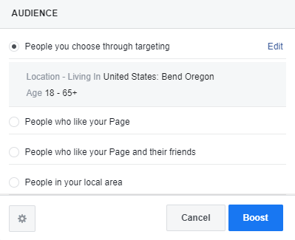
Boost Top-Performing Posts
If you notice that one of your Facebook posts is doing particularly well — earning more likes, comments and shares than normal — consider boosting it to reach more people.
Boosting a post involves paying to amplify its reach. You choose whom to target, with the default being people who like your page. Reach new people by choosing your own audience, being sure to target users near you that have an interest in topics like solar energy and sustainability. You can then choose your budget and schedule, starting at $1/day. Finding the best value can vary, but often $15/day for 3 days is a cost-effective way of spreading your message.

Slide 15
Leverage Partners and Similar Organizations
When you’re sharing stories, news, photos or videos, don’t forget to tag and engage partner organizations so they can help boost your message.
Retweet and share relevant content (articles, videos, infographics, etc.)
Participate in conversations on social media using quote tweets, replies and shares
Share trending information that’s relevant to your audience
You should also be sure to keep an eye on what your partners organizations are sharing to see what’s working for them. This is a great way to discover new opportunities for engagement.

Slide 16
Optimize Your Website
One of social media’s primary functions is as a lead generator for potential subscribers. Many of your social posts will direct users to your website to learn more about your project’s pricing and timeline.
It’s important to make sure they can easily find good, clear and compelling information once they’re on your site.
Include webpages that describe:
How it works
A pricing breakdown. Consider including an example scenario — this can help set expectations and embolden interested users to proceed with the signup process
A dedicated signup page
An about page that tells your story and grounds you in the community
Contact information or a form inviting questions and inquiries
FAQs

Slide 17
Facebook
Best posting times: 9 a.m. on Monday, Tuesday and Wednesday
Keep your content mix fresh.
Helps prevent followers from feeling oversaturated with one topic
High-quality content = more engagement
Facebook’s algorithm prioritizes content with “meaningful interactions.”
High-quality posts ensure it will be seen in users’ feed.
Include calls-to-action at the end of promotional posts to encourage people to take action, attend an event or share

Slide 18
Twitter
Best posting times: Between 9 and 11 a.m., Monday through Friday
Utilize relevant hashtags in tweets to increase visibility among users
Discover more hashtags by seeing what partners are using
Engage with partners, other organizations, and industry leaders by liking, commenting, and retweeting
Follow partner organizations, industry leaders and community members to stay engaged with a relevant audience

Slide 19
Examples

Slide 20
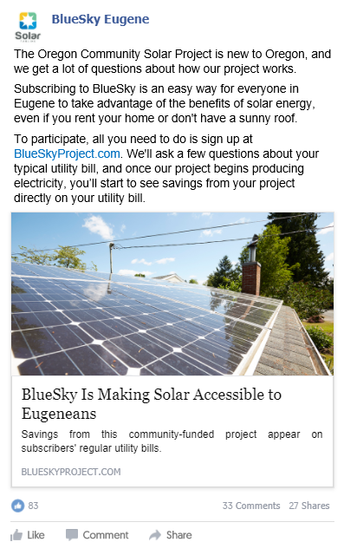
Facebook Sign-Up Post
Use paragraph breaks
Share a link to your sign-up page
Use approachable language
Highlight value proposition

Slide 21
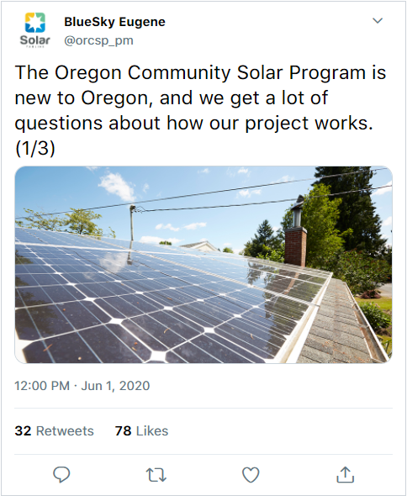
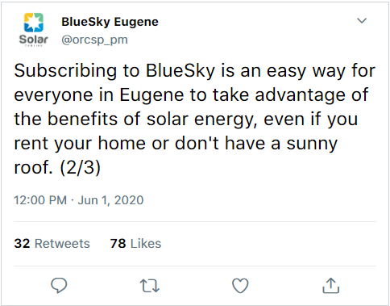
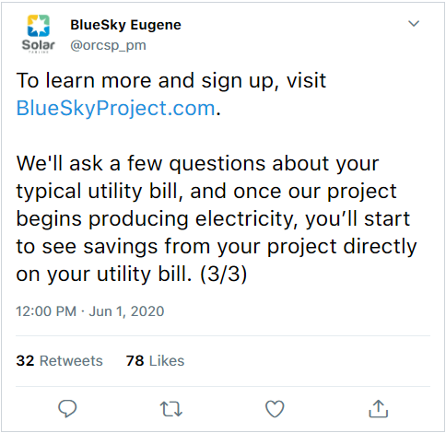
Twitter Sign-Up Thread
Use thread function to post multiple related tweets
Include a high-quality photo
Break into very short paragraphs
Use “(1/X)” to indicate the number of tweets in the thread

Slide 22
Success Indicators

Slide 23
Success Indicators (Organic Social)
Goal: Improving brand/program awareness
Increased followers on Facebook/Twitter
Increased mentions by other orgs/people
Retweets and shares
Stable engagement metrics (impressions, reach, likes, comments)

